Slide 1
INB380 Game Project Lecture 2 SVN and Planning
Ross Brown

Slide 2
Lecture Contents
Project Planning
SVN Demonstrations

Slide 3
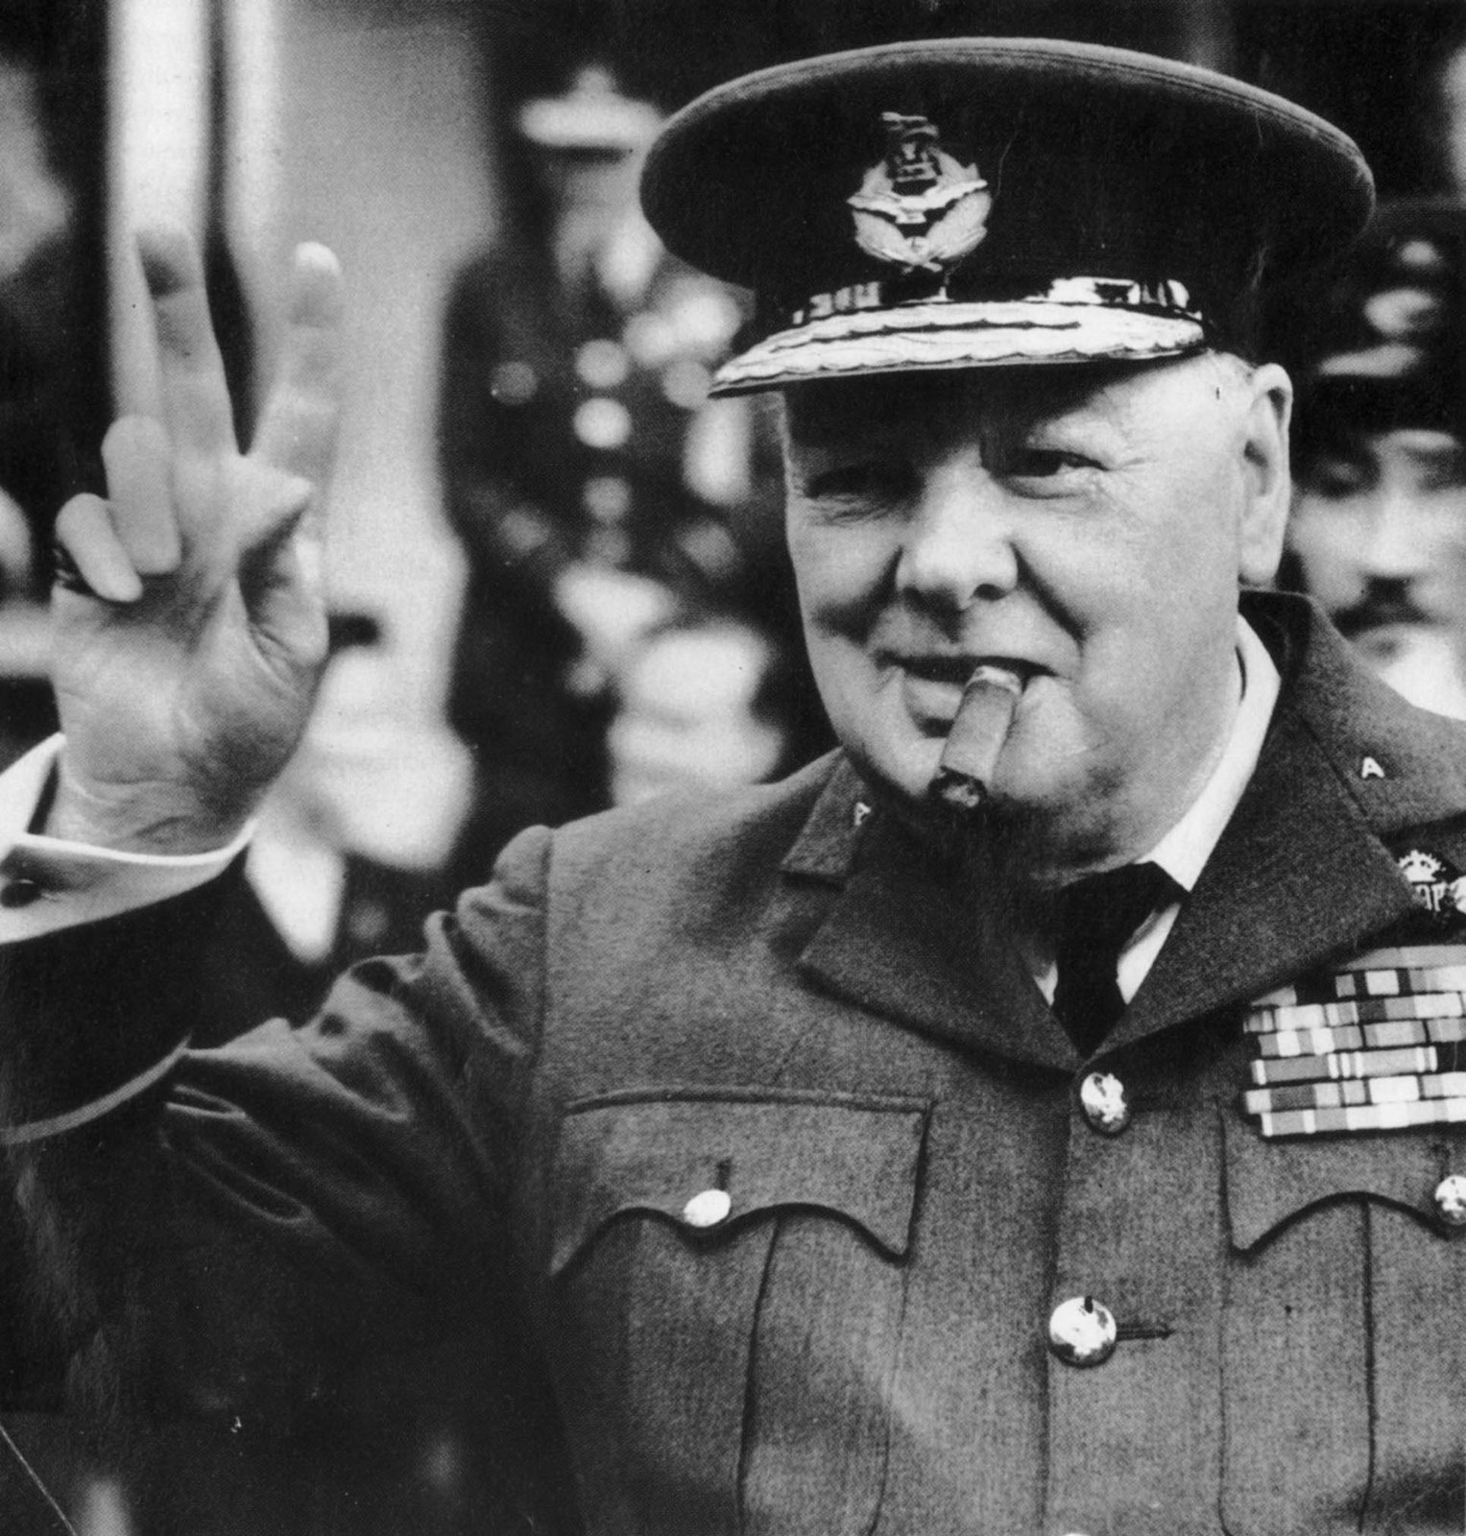
Game Project
"Let our advance worrying become advance thinking and planning" - Winston Churchill

Slide 4

Some Psychology – Brain as Planner
Implementation Intention - writing verb noun pair on average doubles productivity by priming and providing actions against distractions [1]
I have gamified my calendar
Forming a habit of planning becomes unconscious and more common
Planning primes the brain to relax subconsciously
Some planning is better than none
1. Gollwitzer, P. M. (1999). Implementation intentions: Strong effects of simple plans. American Psychologist, 54, 493-503.

Slide 5
Think about your work!
Some Readings:
The Art of Choosing – Sheena Iyengar – Research-based
Succeed: How we can reach our goals – Heidi Grant Halverson – Research-based
So Good They Can’t Ignore You: Why Skills Trump Passion in the Quest for Work You Love - Cal Newport – Manifesto Style
Getting Things Done: The Art of Stress-free Productivity - David Allen – Popular
These present my viewpoint, other people have differing approaches.
Read with an open mind
Track your outputs to see what works under analysis

Slide 6
Weekly Plans
Looking for you to show insight into meeting milestones
Now have four weeks, including this one, to build your game
Should now know characters, mechanics and other assets going into your game
Feel free to use your own tools – but we MUST see a plan

Slide 7
Weekly Plans (Sprint)
Should be able to plan a day in detail as a team – two days spread through a week
Will show an SS example of a fictitious team
Producers get credit for this so spend time on planning
NB: keep track of these plans if team members are not working, useful if needing to resolve conflict
You have to support the plans of the team – share and read the SS (Google Docs)

Slide 8
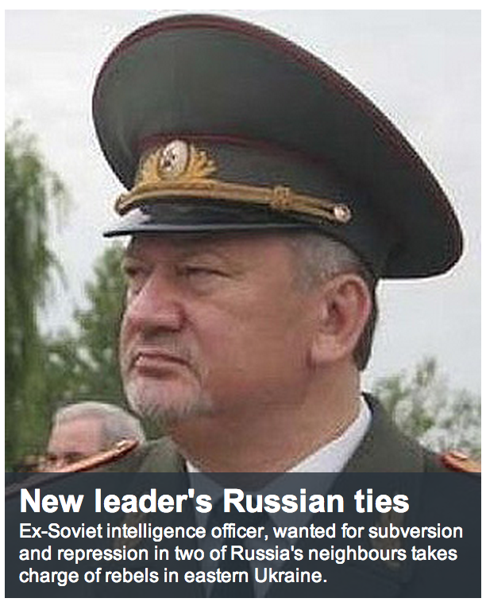
Subversion
Subversion is a client server document repository management system
Can manage any digital content, but best with ASCII source like documents – stores only the changes
Enforces process when dealing with documents – provides better collaboration than Dropbox (sandbox)
Enables conflict resolution and complex forking and merging of directories

Slide 9
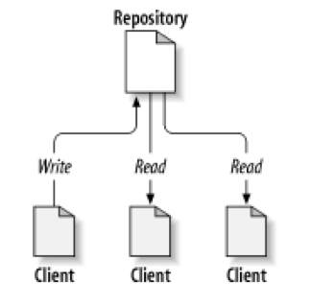
Basics
Connect via client to server – Tortoise, svnX amongst others
You then check out a working copy to modify – thus multiple people can work at once
Aim is to synchronise the working copy with the repository

Slide 10
Subversion Server Basics
Now have a simple demonstration using Unity to get you started for those interested
I will use Windows and Mac (Bootcamp)
Will cover basic creation of repo, checking out, committing
Can look at the INB380 site on Blacksphere for workshops on SVN with Mac and Windows

Slide 11
Unity and SVN Issues
Communicate what you are working on – to minimise conflicts if possible and help merge. Learn to fork.
Keep content/code as separate as possible
Developers – create parameterised scripts for objects
Artists/Modellers/Animators – check your content in game, might create prefabs to merge in project, external to scene file
Level Designer – bring it all together and commit
Sync - developers to drive merges and plan times for merge meeting(s) to have unbroken build

Slide 12
Unity and External Subversion Interaction
Instructions here for integration:
http://docs.unity3d.com/Manual/ExternalVersionControlSystemSupport.html
UDK:
https://www.youtube.com/watch?v=I5Bcz9d-RC0
https://www.youtube.com/watch?v=7jTg3agm7GY

Slide 13
GIT Hubs and INB380
Am happy to allow teams that have GIT hubs to use them
Send me url details of your repo, with user name and password for a brown8 account
Must Invite QUTRossBrown to your Gits

Slide 14
Week 2 - Brief
Today’s meeting:
Build and work review (as always)
Task list review and reality check
Revisit week 1 checklist if not complete
Week 3 meeting:
Build review – log, individual content, hours
Schedule - review, format and reality check

